Slide 1
What are the Eigenvalues of a Sum of (Non-Commuting) Random Symmetric Matrices? : A "Quantum Information" Inspired Answer.
Alan Edelman
Ramis Movassagh
July 14, 2011
FOCM Random Matrices

Slide 2
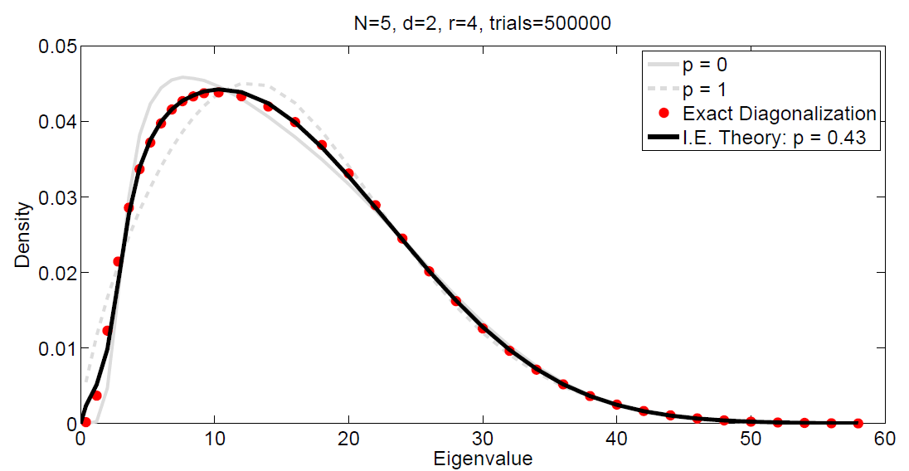
Example Result p=1 → classical probability p=0→ isotropic convolution (finite free probability)
We call this “isotropic
entanglement”

Slide 3
Simple Question
The eigenvalues of
where the diagonals are random, and randomly ordered. Too easy?

Slide 4
Another Question
The eigenvalues of
T
where Q is orthogonal with Haar measure. (Infinite limit = Free probability)

Slide 5
Quantum Information Question
The eigenvalues of
T
where Q is somewhat complicated.
(This is the general sum of two symmetric matrices)

Slide 6
Preview to the Quantum Information Problem
mxm nxn
mxm nxn
Summands commute, eigenvalues add
If A and B are random → eigenvalues are
classical sum of random variables

Slide 7
Closer to the true problem
d²xd² dxd
dxd d²xd²
Nothing commutes, eigenvalues non-trivial

Slide 8
Actual Problem Hardness =(QMA complete)
d^{i-1}xd^{i-1} d²xd² d^{N-i-1}xd^{N-i-1}
The Random matrix could be Wishart,
Gaussian Ensemble, etc (Ind Haar Eigenvectors)
The big matrix is d^{N}xd^{N}
Interesting Quantum Many Body System Phenomena tied to this overlap!

Slide 9
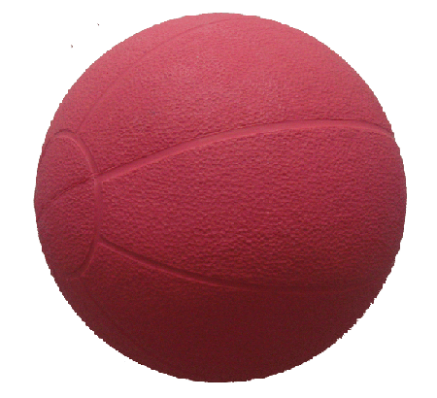
Intuition on the eigenvectors
Classical Quantum Isostropic
Kronecker Product of Haar Measures for A and B

Slide 10
Moments?

Slide 11
Matching Three Moments Theorem

Slide 12
A first try: Ramis “Quantum Agony”

Slide 13
The Departure Theorem
←A “Pattern Match”
Hardest to Analyze

Slide 14
The Istropically Entangled Approximation
The kurtosis
But this one is hard

Slide 15
The convolutions
Assume A,B diagonal. Symmetrized ordering.
A+B:
A+Q’BQ:
A+Q_{q}’BQ_{q}
(“hats” indicate joint density is being used)

Slide 16
The Slider Theorem
p only depends on the eigenvectors! Not the eigenvalues

Slide 17
Wishart

Slide 18
Bernoulli ±1

Slide 20
Summary

