Slide 1
Novel Algebras for Advanced Analytics in Julia
Alan Edelman, Jeff Bezanson
Viral Shah, Stefan Karpinski
Jeremy Kepner
and the vibrant open-source community
Computer Science & AI Laboratories

Slide 2
Google Julia

Slide 3
Julia Facts
Released: February 2012
Used in 6 MIT classes involving scientific computing
Technical Computing Environment
New
Fast
Human
Open Source
Flexible
Scalable for “big data” and “many processors”
You don’t need our permission to try it, or to contribute
Eliminates the word “prototype”
Solves the two language problem
People just seem to like it

Slide 4
Julia in the News
TechCrunch
“Julia is a new language for scientific computing that is winning praise
from a slew of very smart people, … As a language, it has lofty design
goals, which, if attained, will make it noticeably superior to Matlab, R
and Python for scientific programming.”
Written by the author of “Machine Learning for Hackers”

Slide 5
Every Day a New Package At least 200 by now
A hot optimization algorithm used
in machine learning!
Implemented using Julia’s asynchronous
parallel technologies

Slide 6
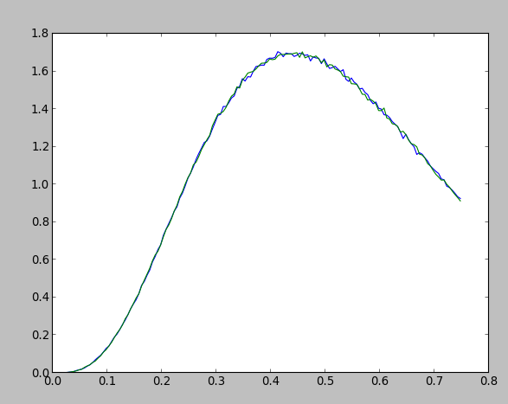
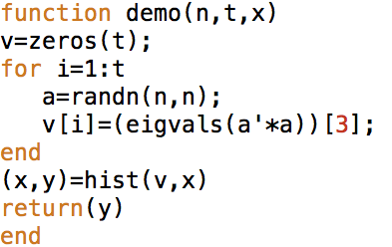
Julia: Parallel Histogram 3rd eigenvalue, pylab plot, 8 seconds! 75 processors

Slide 7
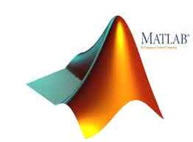
Linear Algebra too limited in
Lets me put together what I need:
e.g.:Tridiagonal Eigensolver
Fast rank one update
Arrow matrix eigensolver
can surgically use LAPACK without tears

Slide 8
Julia Documentation
Well written!
http://docs.julialang.org/en/latest/
google: julia documentation
Much of Julia is written (elegantly!) in Julia – it won’t take you long before you start looking at Julia to learn Julia
Julia cheatsheet
Julia videos
Ijulia notebooks (see max, plus algebras) →

Slide 9
IJulia
MIT Classes serve up Julia on the Cloud
No keys
No installation:
No more, Download, Next, Next, Next, Install
No friction to computation
No need to update
Built on Ipython
CHANGES EVERYTHING!

Slide 10
Ijulia notebook demo

